Slide 1
Marriage Survival Analysis:
Secrets Behind “Happily Ever Afters”
C240B / STAT C245B Project Final Report
Z. Tom Hu
Sijin Wu

Slide 2
1. Overview 2. Research Goal Motivations 3. TMLE and COX 4. Conclusion
Content

Slide 3
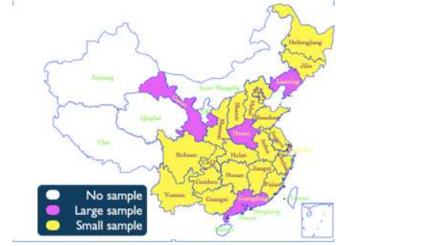
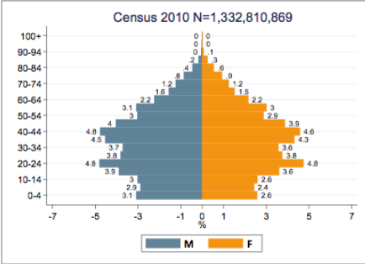
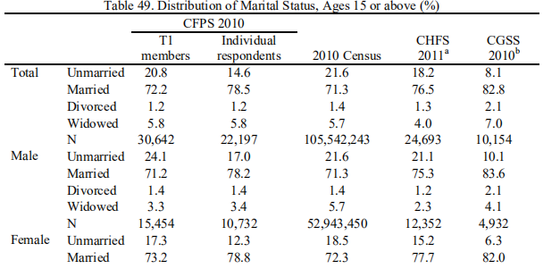
1. Overview
China Family Panel Studies（CFPS） of 2010, 2012, 2014, 2016, 2018.
Each of them has about 30000 samples with 1000 covariates. Sample distribution is balanced in gender and marriage state, unbalanced in region.

Slide 4
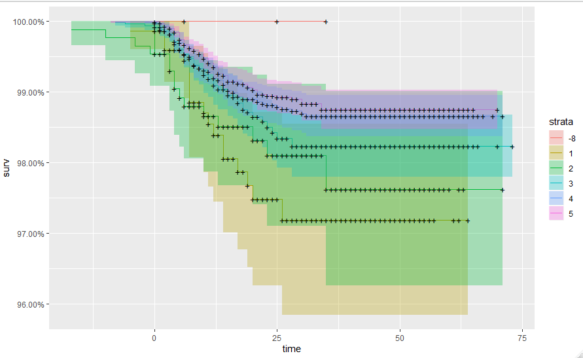
2. Research Goal Motivations
treatment=qm505
Motivation 1：Recall from our last presentation, we have shown that using some machine learning methods it can be shown that covariate qm505 is highly correlated with wedding time. qm505 is measuring how intolerable the interviewee thinks about loneliness, in a scale of 1 to 5.
Notes:
在上次presentation的最后，我们使用了一些变量选择的办法，考察了几千个变量之间和它们对婚姻时间的影响，期中有明显效果的是qm505，它代表的意思是：孤独感对于受访者的重要程度，1到5越高代表越重要。

Slide 5
2. Research Goal Motivations
Motivation 2：At the beginning we set all covariates except wedding time as baseline covariates. However, only MOSS package supports censored data among current TMLE packages.
But we have a large dataset, and different covariates have different patterns of missingness. Thus we have to do a variable selection based on missingness.
We then used the initial_sl_fit() in (MOSS) to specify the data (as defined it above) and the SuperLearner library for initial estimation. The data size we used is of 25000 samples and 1400 features. It took about 4 hours of training and resulted in a vector whose size was larger than 7M, which meant the result is invalid.
We need to ''slim down'' the data again.
Notes:
最初，我们打算在实际使用TMLE时，把除了婚姻寿命以外的变量都当成baseline covariates，但是出现了很多问题，其中之一就是，目前，支持删失数据格式的TMLE框架中，只有MOSS package。 但是由于我们的数据量实在太大，并且每一个变量都有不同程度的缺失值，而当前的框架对缺失值很敏感，我们不得不根据缺失变量值进行变量的筛选。
在解决了缺失值问题后，We used the initial_sl_fit() function(MOSS) to specify the data (as we defined it above) and the SuperLearner library for initial estimation. 在这一步中，我们使用的数据size约是25000*1400 ，不仅训练时间长达3个半小时，results的vector size was larger than 7M, which meant the result is valid.
We have to ''slim down'' the data again.

Slide 6
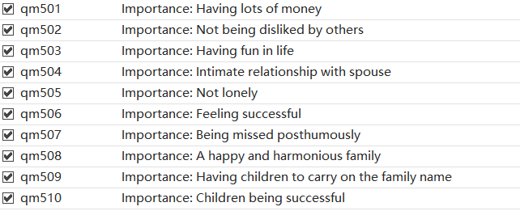
2. Research Goal Motivations
From Motivation 1, we realize that ”internal” covariates might be more important, such as:
All of them are in a scale of 1 to 5.
We also select income rank, education level, appearance, IQ, expression ability and social status as “external” covariates for comparison. These covariates are in a scale of 1 to 8.
We want to infer the effects of these covariates as treatment through simultaneous inference curve.
Notes:
我们的研究目标，本来是想利用生产分析，从几千个变量中找出合适的，有效的treatment ，但是由于能力有限，不得不改变思路。
我们只选择我们关注的变量，通过之前的motivation 1， 我们发现，影响婚姻长度的不仅仅只是我们想象的那样：个体的外在标签，例如财富，学位，地位，外貌等，还应该有个体的内在信息。幸运的是，我们的数据集里包含了比较丰富的这方面的数据。
受访者会根据认可程度从1到5中选择。我们认为这10个变量可以描述对应的十种性格类别，进一步探究这种性格对婚姻寿命的影响。 除此以外，我们还选择了：income rank,education level,appearance，IQ, expression ability，social status作为外部影响因素。
它们也都是整数型数据（1：8），数字越大代表对应的能力越强。
我们希望通过simultaneous inference curve来判断，这些变量作为treatment的效

Slide 7
2. Research Goal Motivations
Moss requires binary treatments…
Internal: We separate into two classes (<=3) and (>= 4)
External: We separate into two classes (<=5, >= 6)
These cutoffs are selected by our background knowledge. For example, as for degree, 6 = bachelor, 7 = master and 8 = PhD.
We then did a conditional sampling based on censored and complete data with finally 2500 samples.
Notes:
II因为在使用现有的MOSS框架时，指定的treatment必须是二元的，所以我们对于选取的每个变量都进行了一定的处理。
对于内部因素：我们根据 重要程度<3 和>=4分为两类。
对于 外部因素：我们想观察在这些方面极其优秀是否会对他们的婚姻有明显的影响，所以我们以得分 ： 分成<=5 ，>=6两类。
（例如学位，6是本科学位，7是硕士学位，8是博士学位，在2010年的中国，本科学位已经高级知识分子）
在纬度上进行瘦身之后，面对数据量巨大的数据集，MOSS还是有些吃力，在助教的建议下，我按照比例对censored，complete数据进行分层抽样，得到2500个样本，再进行进一步的estimation。

Slide 8
3. TMLE
Since MOSS have some problems to deal with estimating the exact average treatment effect:
We plot the Simultaneous Confidence Survival Curve by TMLE with different treatment on the same plot and observe if there is a distinct difference.

Slide 9
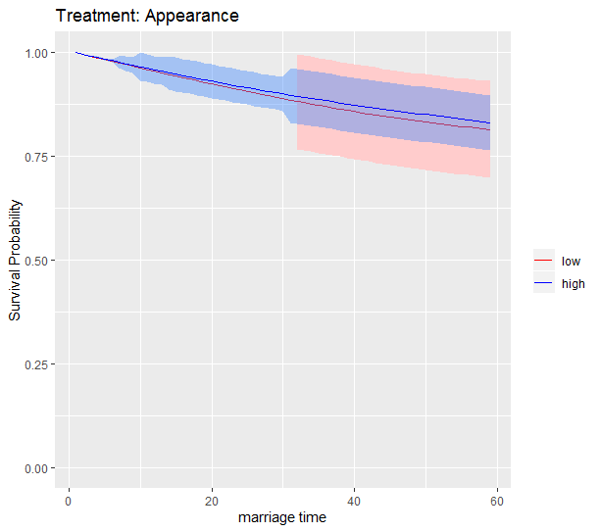
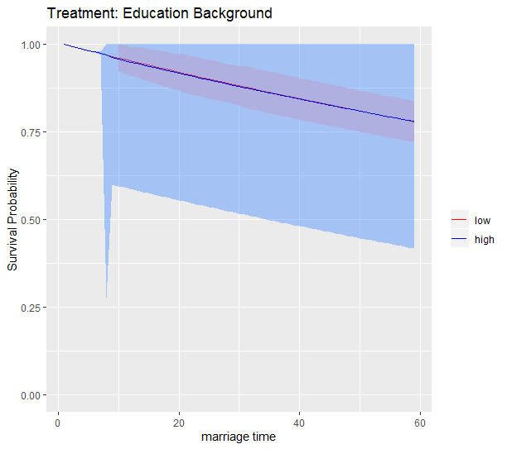
3. TMLE: External Covariates
The outcomes of external covariates: We can say that they nearly have no obvious effect on marriage lifespan.

Slide 10
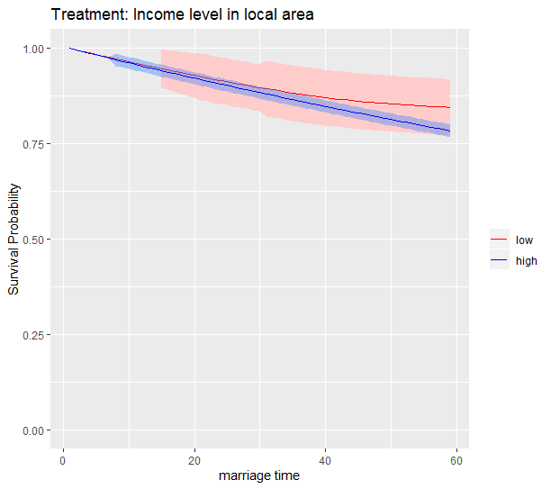
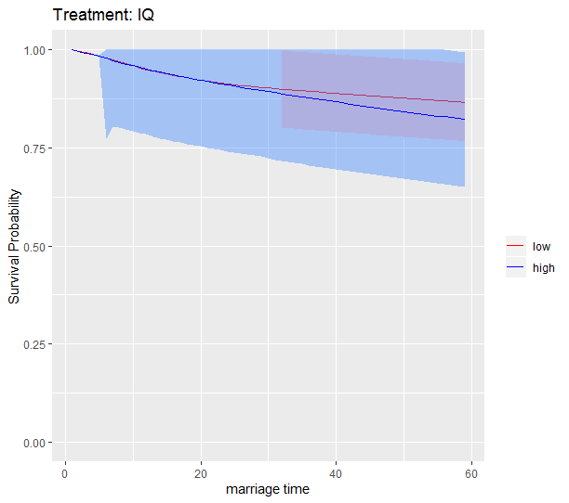
3. TMLE: External Covariates
The outcomes of external covariates: We can say that they nearly have no obvious effect on marriage lifespan.

Slide 11
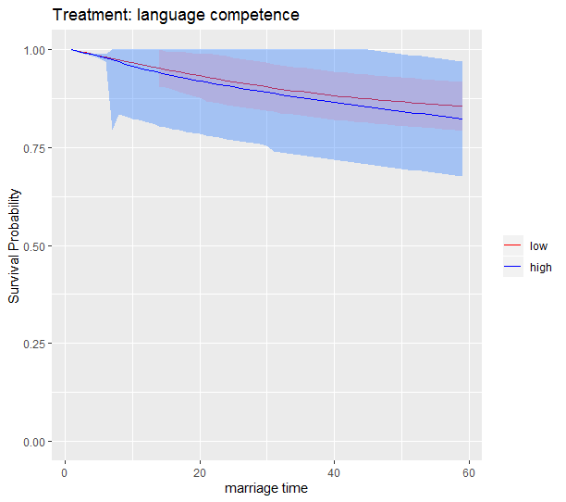
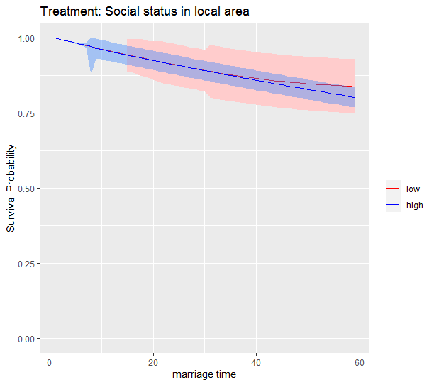
3. TMLE: External Covariates
The outcomes of external covariates: We can say that they nearly have no obvious effect on marriage lifespan.

Slide 12
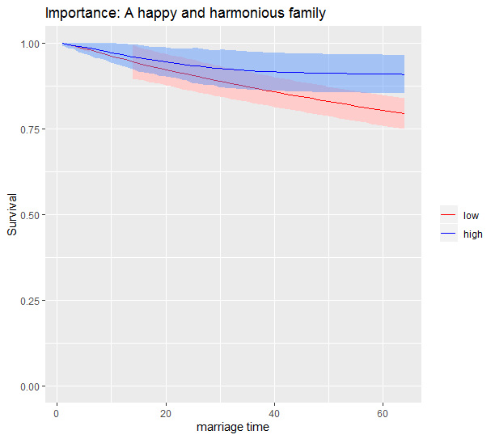
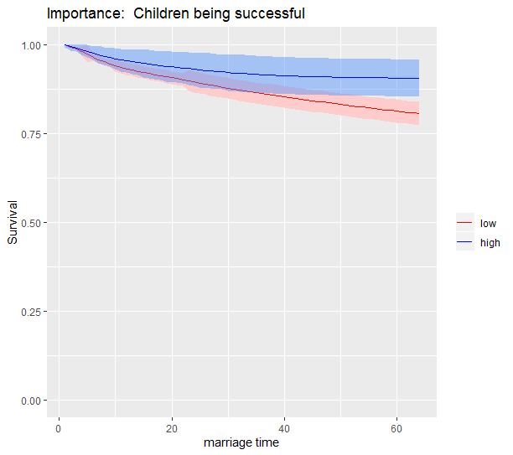
3. TMLE: Internal Covariates
These internal covariates as treatments cause a distiction between different treatments.

Slide 13
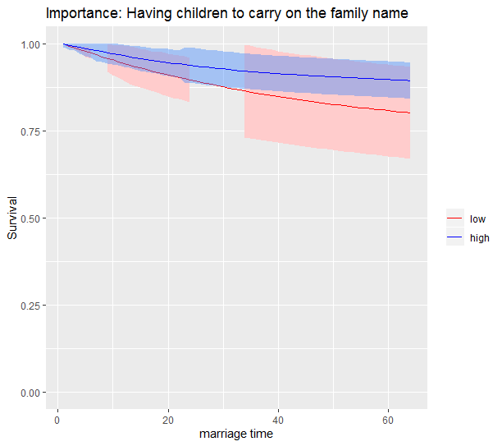
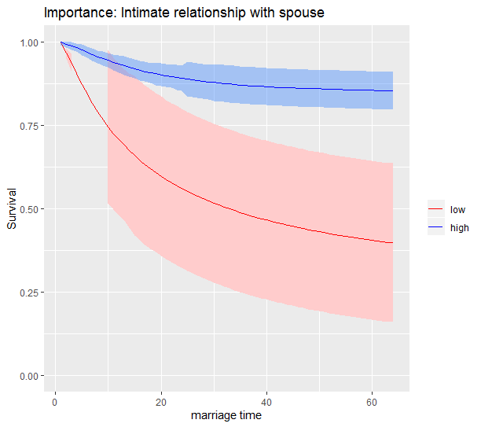
3. TMLE: Internal Covariates
Another set of internal covariates.

Slide 14
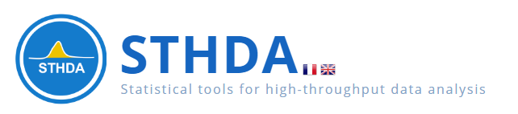
3. COX
In this project, we also tried the COX model to see the difference of the results through 2 different approaches.
Here, we’ll disscuss three types of diagonostics for the Cox model:
Testing the proportional hazards assumption.
Examining influential observations (or outliers).
Detecting nonlinearity in relationship between the log hazard and the covariates.
In order to check these model assumptions, Residuals method are used. The common residuals for the Cox model include:
Schoenfeld residuals to check the proportional hazards assumption
Martingale residual to assess nonlinearity
Deviance residual (symmetric transformation of the Martinguale residuals), to examine influential observations
We will use the ''survival'' and ''survminer'' to do the cox regression and cox assumption tests for external and internal covariates seperately.

Slide 15
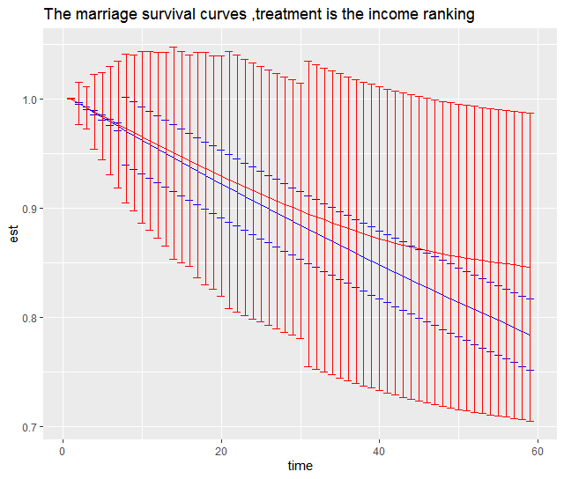
3. COX: External Covariates Compared with TMLE's results: the local income rank

Slide 16
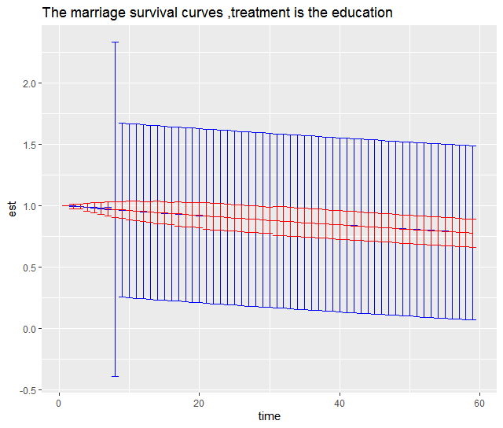
3. COX: External Covariates Compared with TMLE's results: education

Slide 17
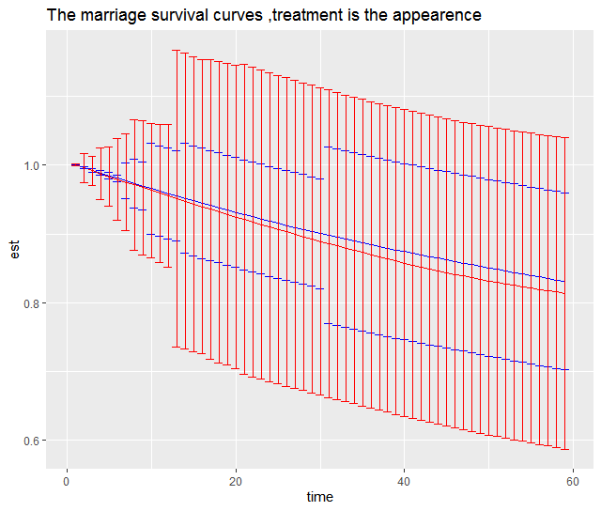
3. COX: External Covariates Compared with TMLE's results: appearence

Slide 18
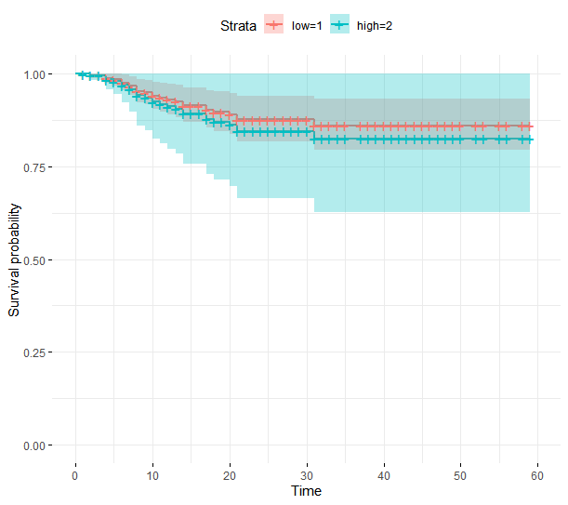
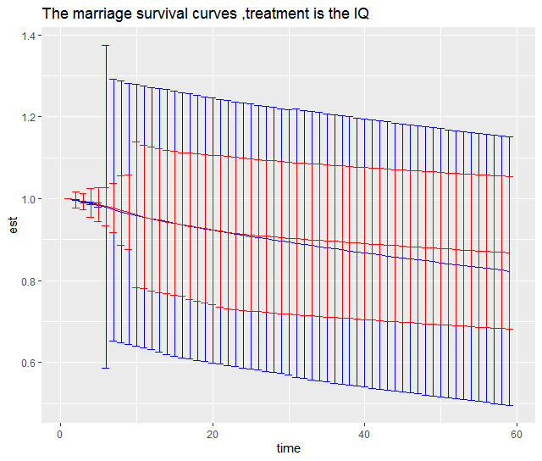
3. COX: External Covariates Compared with TMLE's results: IQ

Slide 19
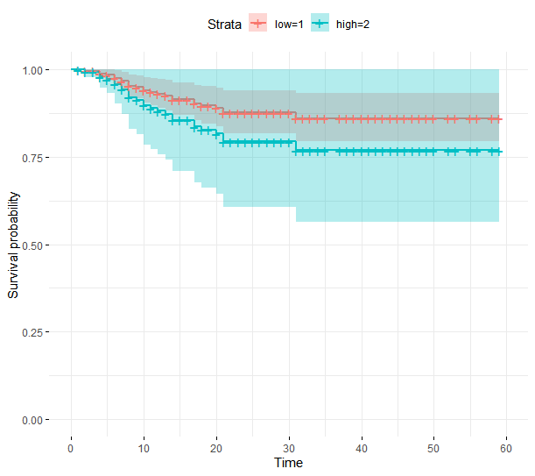
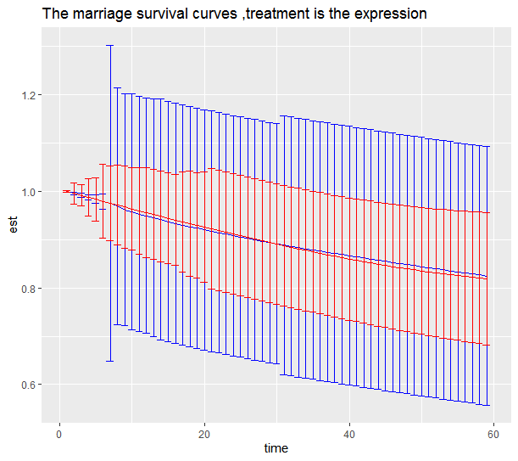
3. COX: External Covariates Compared with TMLE's results : expression ability

Slide 20
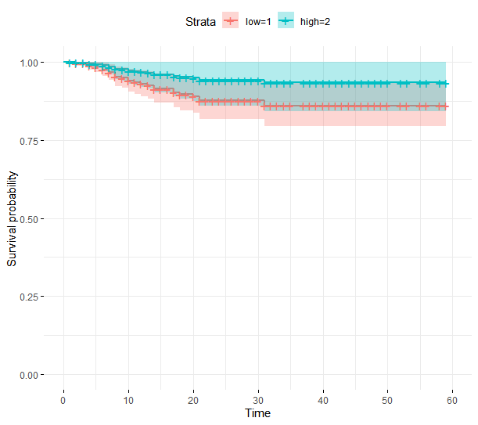
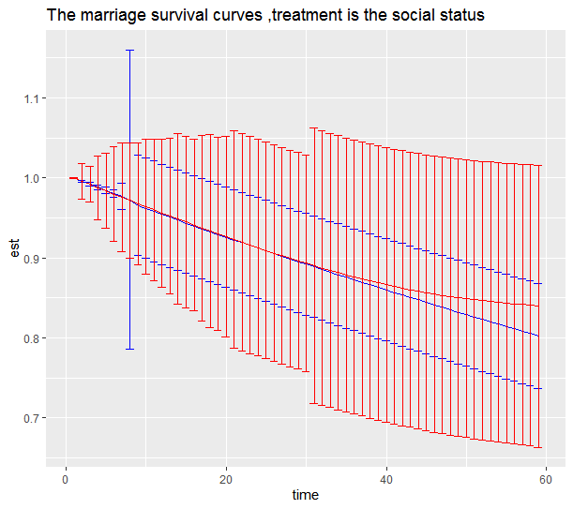
3. COX: External Covariates Compared with TMLE's results: local social status

Slide 21
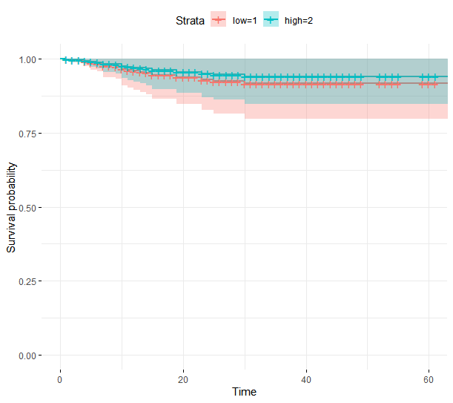
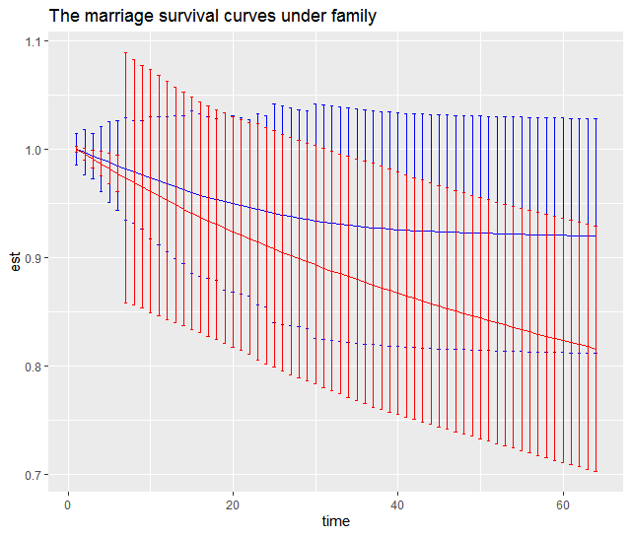
3. COX: Internal Covariates Compared with TMLE's results: importance of family

Slide 22
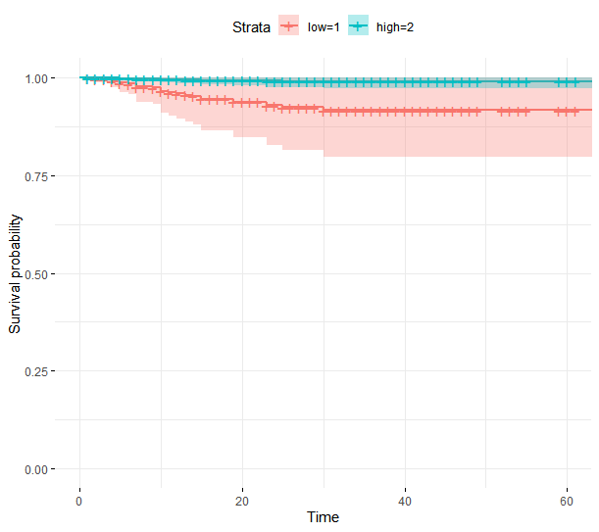
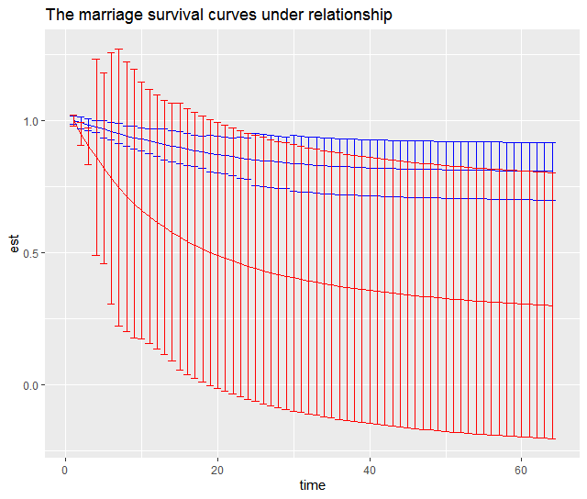
3. COX: Internal Covariates Compared with TMLE's results: importance of couple's relation

Slide 23
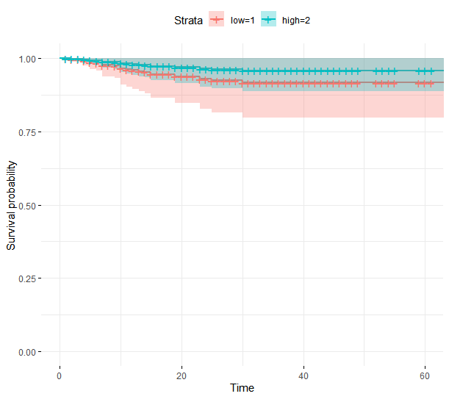
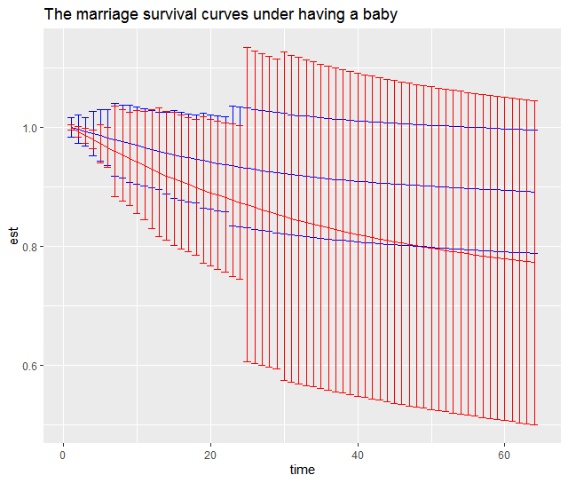
3. COX: Internal Covariates Compared with TMLE's results: importance of having the offspring

Slide 24
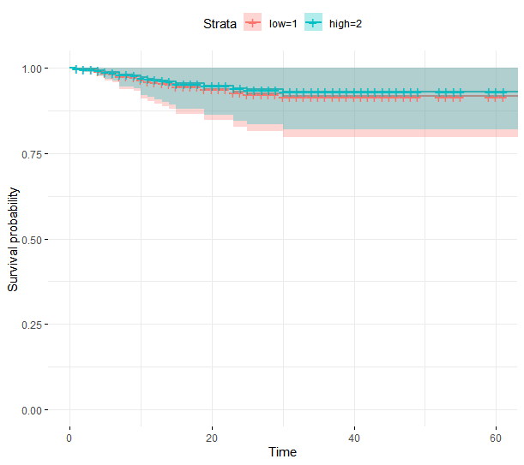
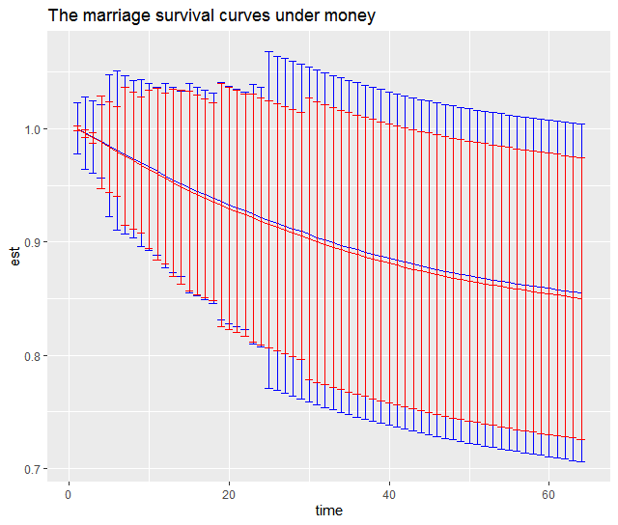
3. COX: Internal Covariates Compared with TMLE's results: importance of money

Slide 25
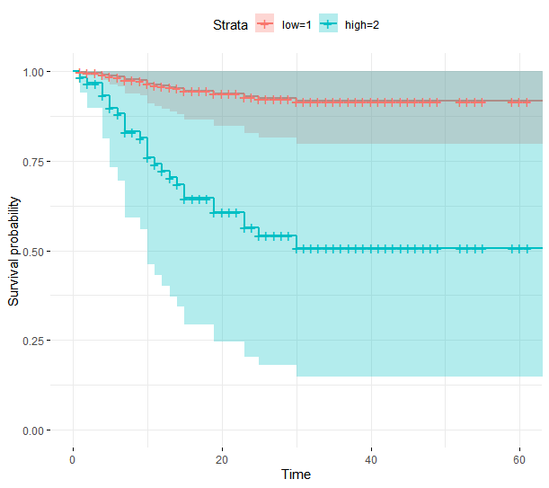
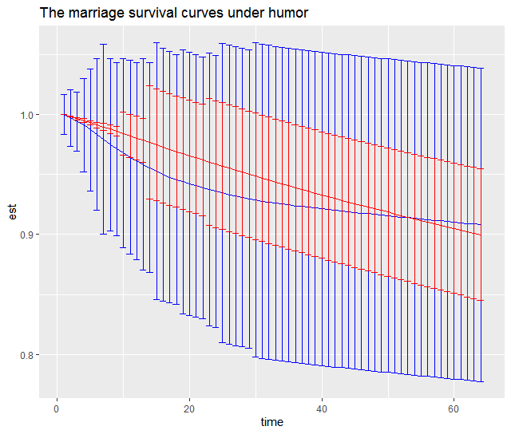
3. COX: Internal Covariates Compared with TMLE's results: importance of humor

Slide 26
4. Conclusion
Two approaches do have different survival curves, possibly due to different assumptions
But no mater TMLE or COX, we can see that internal covariates have much bigger impact on your wedding length, especially those who think relations are important / families are important have a far longer survived wedding than those who do not.
Due to time and knowledge constraint, we exclude some of our data and must conduct variable selection by hand. We would be interested to see TMLE applied to large scale data.
Notes:
1 Two approaches get different survival curves, cox模型的结果更贴近于生活中的理解。
2 不论是cox还是TMLE的模型，我们都可以看到，一个人是否爱财并不影响婚姻寿命，一个人接受的教育程度也对婚姻寿命没有太大的影响，恰恰是那些内在的原因，一个珍视家庭关系，珍视夫妻关系的人，婚姻寿命会更长。
3 这个project也有一些遗憾，为了满足框架，我们牺牲了很多数据信息，另一方面，数据无法告诉我们夫妻之间的契合程度，我们无法从夫妻的相似程度来分析婚姻寿命。

Slide 27
Thanks for your attention! Questions?

Slide 28
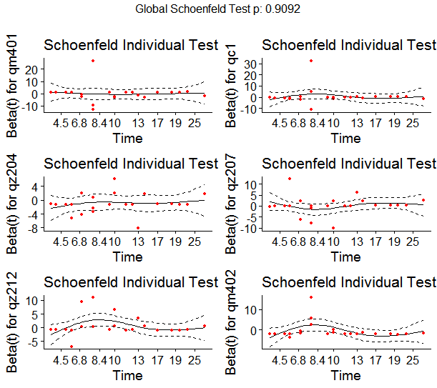
3. COX: External Covariates
Testing proportional Hazards assumption：
rho chisq p
qm401 -0.0292 0.0232 0.879
qc1 -0.0606 0.1358 0.712
qz204 0.1480 0.3968 0.529
qz207 0.0867 0.2532 0.615
qz212 -0.0722 0.1597 0.689
qm402 -0.1790 0.7297 0.393
GLOBAL NA 2.1108 0.909
The proportional hazard assumption is supported by a non-significant relationship between residuals and time and refuted by a significant relationship. So the test is not statistically significant for each of the covariates, and the global test is also not statistically significant. Therefore, we can assume the proportional hazards.
From the graphical inspection, there is no pattern with time. The assumption of proportional hazards appears to be supported
Model Output:
coef exp(coef) se(coef) z Pr(>|z|)
qm401 0.07081 1.07337 1.22007 0.058 0.954
qc1 0.50615 1.65889 1.13753 0.445 0.656
qz204 -0.91297 0.40133 0.62725 -1.456 0.146
qz207 0.24194 1.27371 0.68591 0.353 0.724
qz212 0.55712 1.74564 0.62895 0.886 0.376
qm402 -0.79319 0.45240 0.79801 -0.994 0.320
exp(coef) exp(-coef) lower .95 upper .95
qm401 1.0734 0.9316 0.09823 11.729
qc1 1.6589 0.6028 0.17846 15.420
qz204 0.4013 2.4917 0.11738 1.372
qz207 1.2737 0.7851 0.33206 4.886
qz212 1.7456 0.5729 0.50885 5.988
qm402 0.4524 2.2104 0.09468 2.162

Slide 29
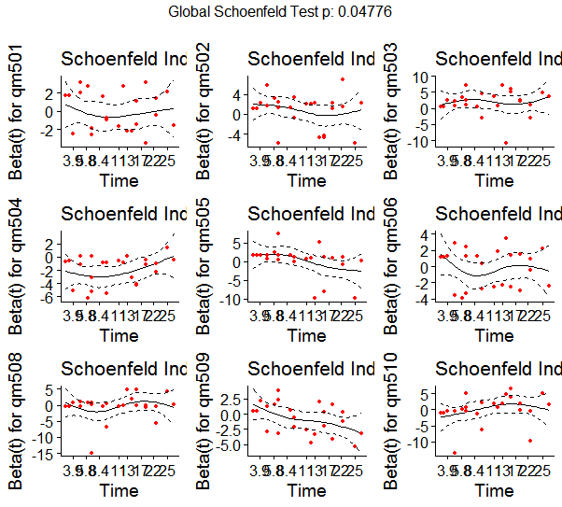
3. COX: Internal Covariates
Model Output
coef exp(coef) se(coef) z Pr(>|z|)
qm501 -0.1832 0.8326 0.4332 -0.423 0.67238
qm502 0.8938 2.4443 0.5487 1.629 0.10335
qm503 2.0573 7.8246 0.7464 2.756 0.00585 **
qm504 -2.1732 0.1138 0.4446 -4.888 1.02e-06 ***
qm505 0.2707 1.3109 0.6293 0.430 0.66710
qm506 -0.2008 0.8181 0.4303 -0.467 0.64072
qm508 -0.3519 0.7033 0.7491 -0.470 0.63849
qm509 -0.7082 0.4925 0.4437 -1.596 0.11047
qm510 0.1107 1.1171 0.7340 0.151 0.88011
---
Signif. codes: 0 ‘***’ 0.001 ‘**’ 0.01 ‘*’ 0.05 ‘.’ 0.1 ‘ ’ 1
exp(coef) exp(-coef) lower .95 upper .95
qm501 0.8326 1.2010 0.35622 1.9461
qm502 2.4443 0.4091 0.83386 7.1651
qm503 7.8246 0.1278 1.81180 33.7923
qm504 0.1138 8.7863 0.04761 0.2721
qm505 1.3109 0.7629 0.38185 4.5001
qm506 0.8181 1.2224 0.35201 1.9012
qm508 0.7033 1.4218 0.16200 3.0535
qm509 0.4925 2.0304 0.20641 1.1752
qm510 1.1171 0.8952 0.26502 4.7085
Concordance= 0.788 (se = 0.043 )
Likelihood ratio test= 33.71 on 9 df, p=1e-04
Wald test = 36.22 on 9 df, p=4e-05
Score (logrank) test = 37.49 on 9 df, p=2e-05
Testing proportional Hazards assumption：
rho chisq p
qm501 -0.0310 0.02291 0.87969
qm502 -0.2159 1.65367 0.19846
qm503 0.0127 0.00374 0.95122
qm504 0.3000 2.24812 0.13378
qm505 -0.4213 6.36991 0.01161
qm506 -0.0676 0.12877 0.71971
qm508 0.1412 0.50605 0.47685
qm509 -0.4719 6.84962 0.00887
qm510 0.2541 2.20108 0.13791
GLOBAL NA 17.06153 0.04776

